Slide 1
Child Participation
Capacity Building Training Session on ‘Rights Based Approach to Child Rights and Welfare Programming’
Emebet Mulugeta
Associate Professor, AAU
Director, Nia Center for Children and Family
Development (Nia CCFD)

Slide 2
Brainstorming on Child Participation
How do you define a child?
What is ‘child participation’?
What are the characteristics of children in terms of age and different dimensions of development that are relevant to child participation?
What are your experiences in implementing the concept/principle of child participation?

Slide 3
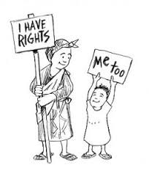
Child Participation
Child participation is an informed and willing involvement of all children including those that are differently abled and those at risk any way, concerning them either directly or indirectly (CWA).
It is a process of sharing decisions which affect one’s life and the life of the community in which one lives.

Slide 4

Provisions on Child Participation
Convention on the Rights of the Child (CRC)
  Article 12.1. to the child who is capable of forming his or her own views the right to express those views freely in all matters affecting the child, the views of the child being given due weight in accordance with the age and maturity of the child.
  Article 13.1. the right to freedom of expression and to receive information in different forms and means.
African Charter for the Rights and Welfare of the Child
  Article 7: Every child who is capable of communicating his or her own views shall be assured the rights to express his opinions freely in all matters and to disseminate his opinions subject to such restriction as are prescribed by laws.

Slide 5
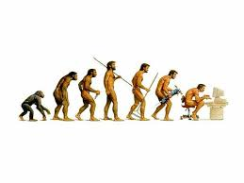
Assumptions about Childhood/CP
Earlier thinking.
  1924 - the Geneva Declaration on the Rights of the Child;
  1959 - the United Nation issued the Declaration on the Rights of the Child; three basic rights:
    the right to survival,
    the right to protection, and
    the right to development.
  1979, was named the International Year of Children;
  1989, the Convention on the Rights of the Child (CRC);
The new sociology of childhood: agency and resilience.

Slide 6
Importance of Child Participation
It is a right stipulated in international and regional instruments.
It is one of the instruments for ensuring the best interest of the child is considered.
Projects become more beneficial to children.
Children acquire skills in expressing their opinions.
They develop confidence in themselves.
Children get opportunities to play a major role.
Children develop the value of listening to children, children’s participation to enable the cycle of authoritarianism.

Slide 7
Types of Participation
Manipulation
Decoration
Tokenism
Assigned but informed
Consulted and informed
Adult initiated, shared decisions with children
Child initiated and directed
Child initiated, shared decisions with adults
Hart, Roger. (1992).Children’s participation: from tokenism to citizenship. UNICEF International Child Development Centre, Spedale degli lnnocenti, Florence, Italy.

Slide 8
Points to Remember
With every right comes equal responsibility.
The degree and type of and activities for participation vary on several factors related to children as well as adults involved and the larger community.
Participation of children does not end when a child speaks or sits in a meeting.

Slide 9
The Path towards Genuine CP
Make children’s participation a policy;
Build the necessary capacity;
Aim for the highest level of participation;
Know the issue or the problem;
Know the children: their age, their capacity – physically, socially, etc.
Listen to the voice of children;

Slide 10
The Path towards Genuine CP…
Provide information and support;
Give orientation or training on relevant information, structure, connection and resources;;
Pay attention to the process as much as to the goals;
Try to be the facilitator and provider of backstopping services not the leader or decision maker; and
Aim for the highest level of participation.

Slide 11

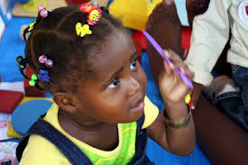
Factors for Consideration in Child Participation:
  Age (Developmental Stage)
    Infancy – the first two years
    Learning to form associations and think
    through interaction with the environment.
    Early Childhood- two to six years.
    Limited memory, appearance of
    symbolic thought, lack of operations , internalized actions that children could perform in their heads– conservation, centration, reversibility.

Slide 12


    Middle Childhood–five to eleven.
      Concrete operational thinking
      children are much better able to
      understand logical principles,
      inability to list out alternatives.
    Puberty and Adolescence: eleven to eighteen.
    Abstract thinking, systematic and logical ,
    hypothetical thinking.

Slide 13
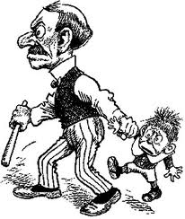
  Socio-cultural context
    How we are raised
    How we raise our children
    What values we give to children
  Level of awareness of adults (actors involved)
  Resources
    Trained personnel
    Time
    Money

Slide 14
THANK YOU

